Slide 1
Vehicle Collisions
2009-2013
CIS 3200
Andrew Rosalino
Tan Huynh
Sareena Grajeda
Aylin Ignacio

Slide 2
Introduction
This data set is about vehicle collisions that happened in the Los Angeles area from 2009 to 2013. It will include the severity of the collision, the date, and more. We will map out which collisions occur during specific conditions, and see what factors in those areas that could be accountable for the higher number of collisions, which will allow us to perform a prediction of the collisions based on the data. The data set will also show us any injuries that were obtained as well as seeing what the weather conditions were at the time of the collision and if there is a correlation between them.

Slide 3
Data Source
http://geohub.lacity.org/datasets/ladot::collisions-2009-2013-switrs
GeohubLACity is a website that records data and information in LA City pertaining to health, safety, transportation, education and much more. The data used in our experiment was collected from 2009-2013 using the Statewide Integrated Traffic Records System (SWITRS). The data is a collection of all recorded traffic collisions occurring in the LA City jurisdiction.

Slide 4
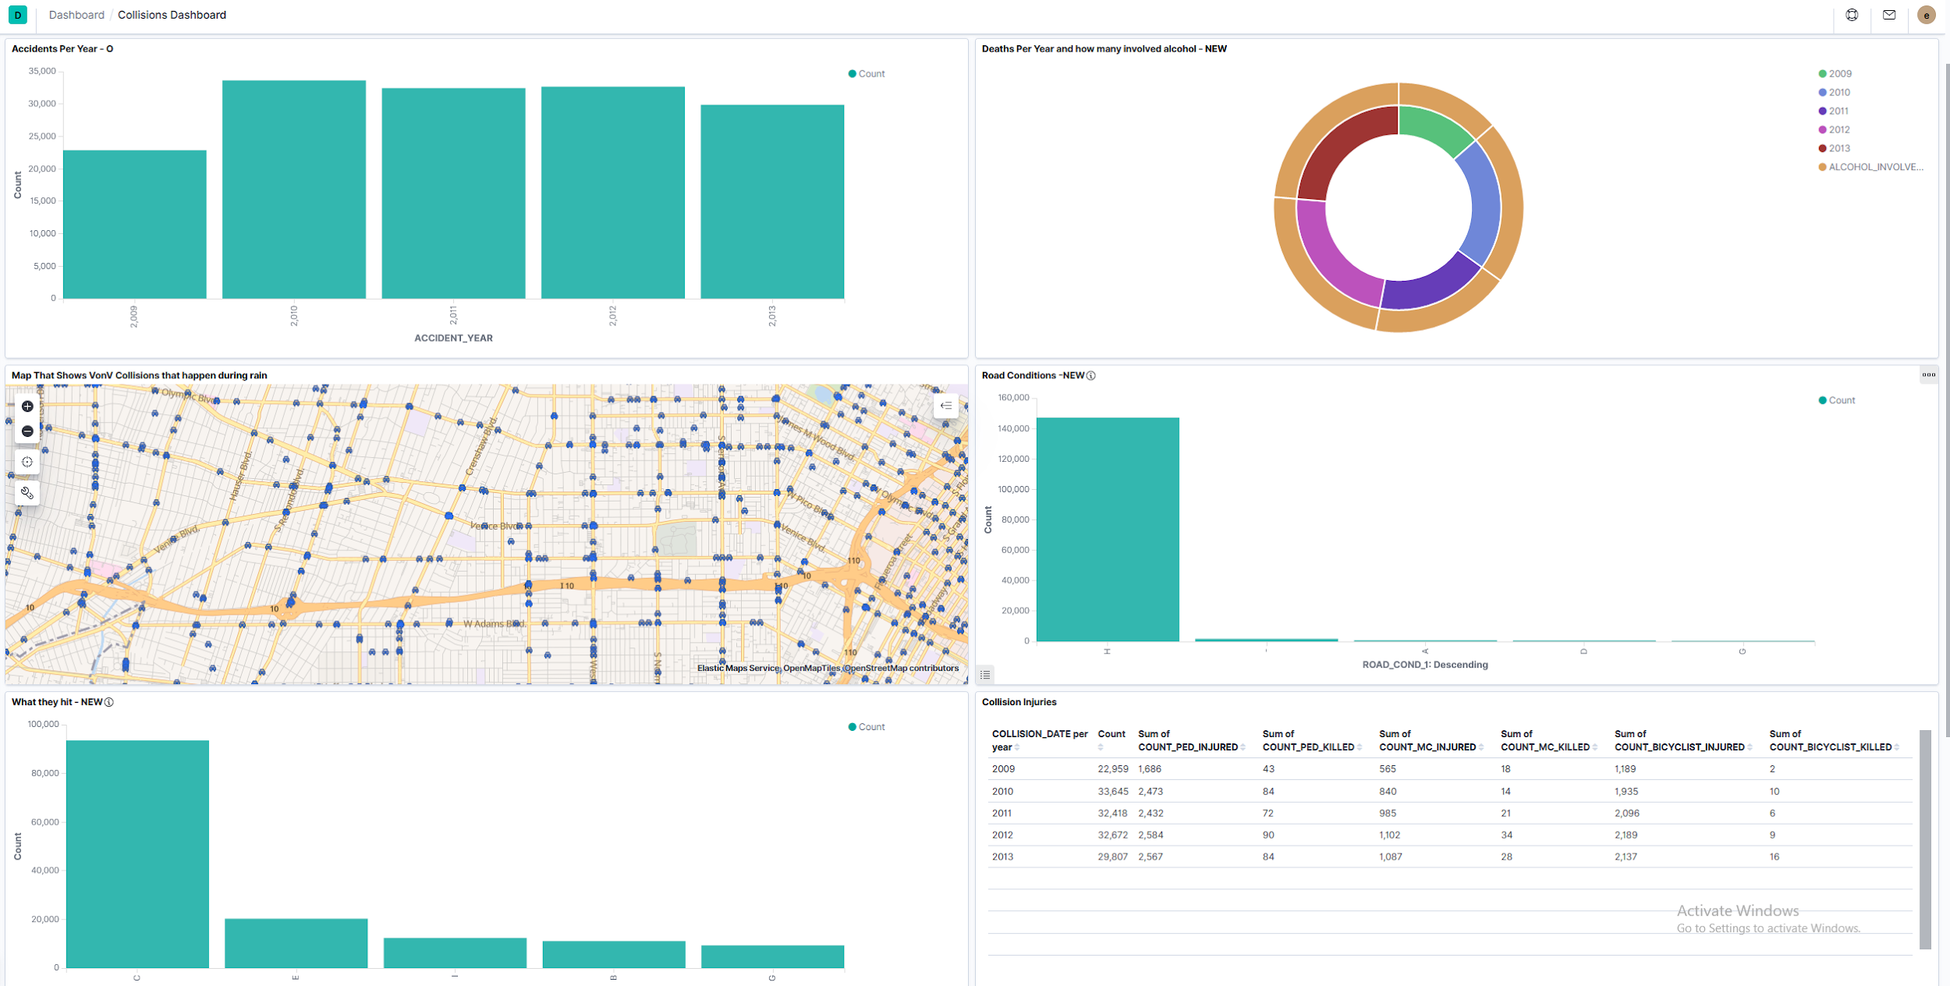
Collisions Dashboard

Slide 5
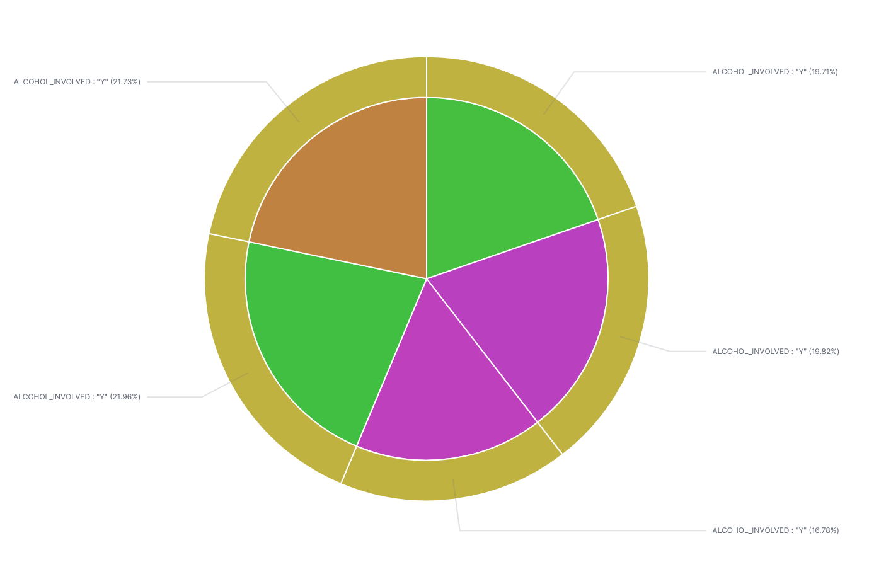
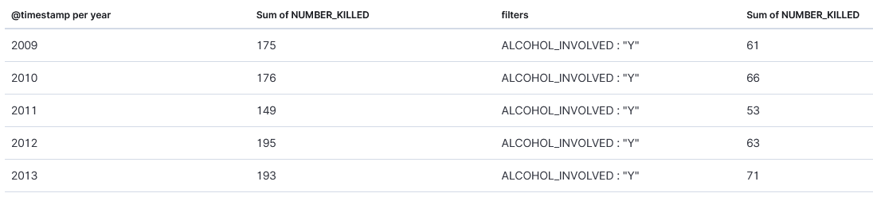
Deaths per year
Pie chart showing vehicle collision deaths for each year, and number of those involving alcohol

Slide 6
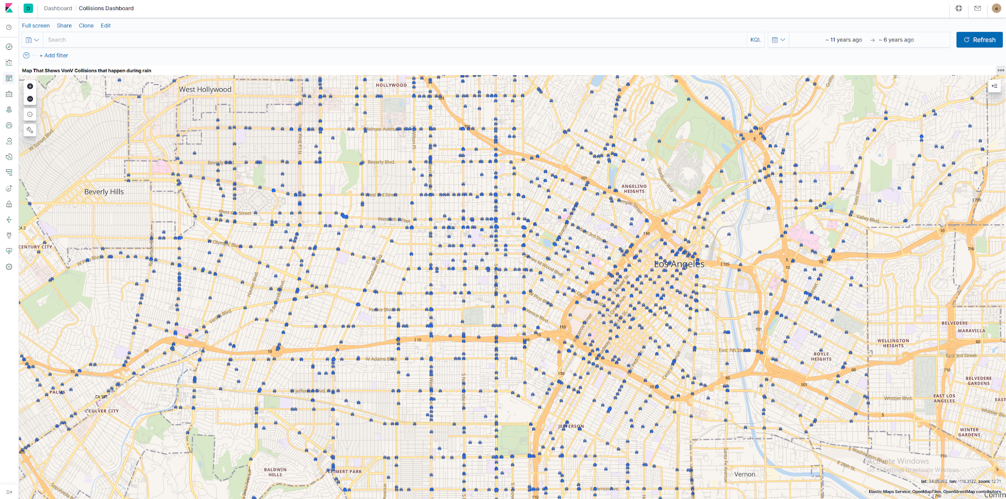
Weather Conditions - This map plots out all collisions between 2 vehicles that happened during rainy weather.

Slide 7
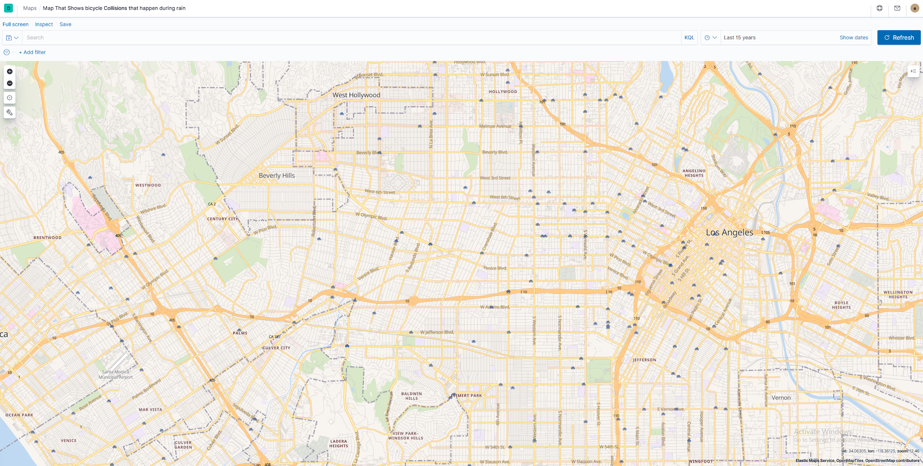
Collisions Between Car and Bicycle During Rainy weather

Slide 8
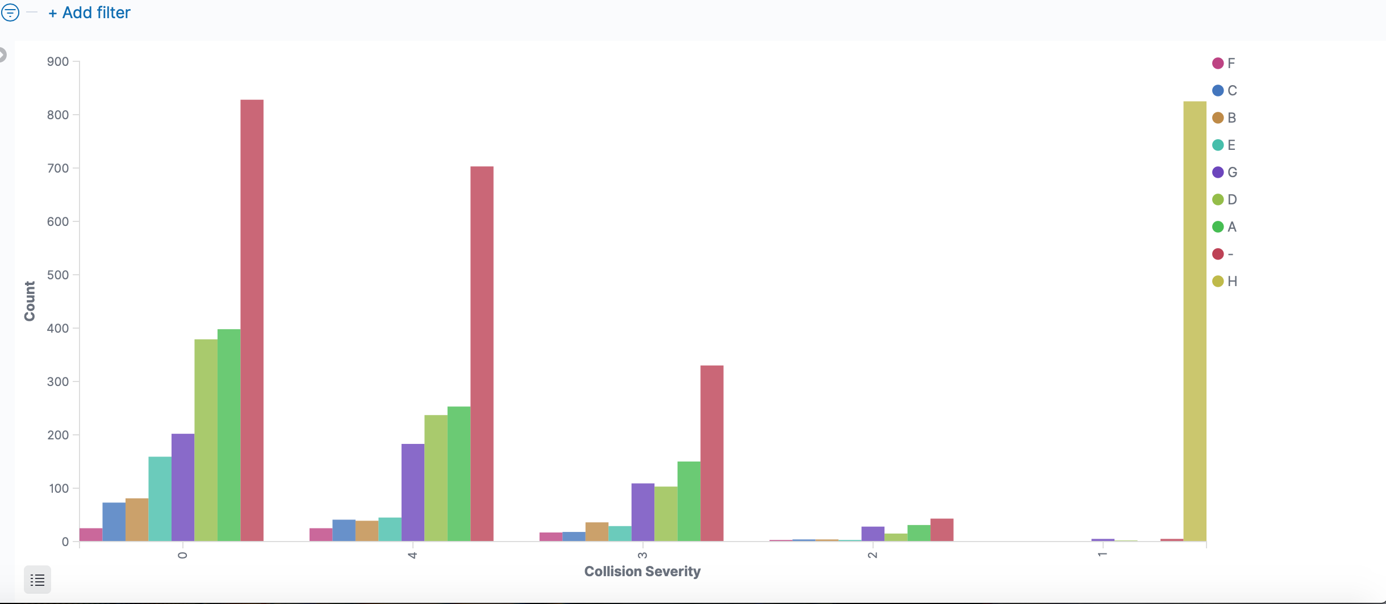
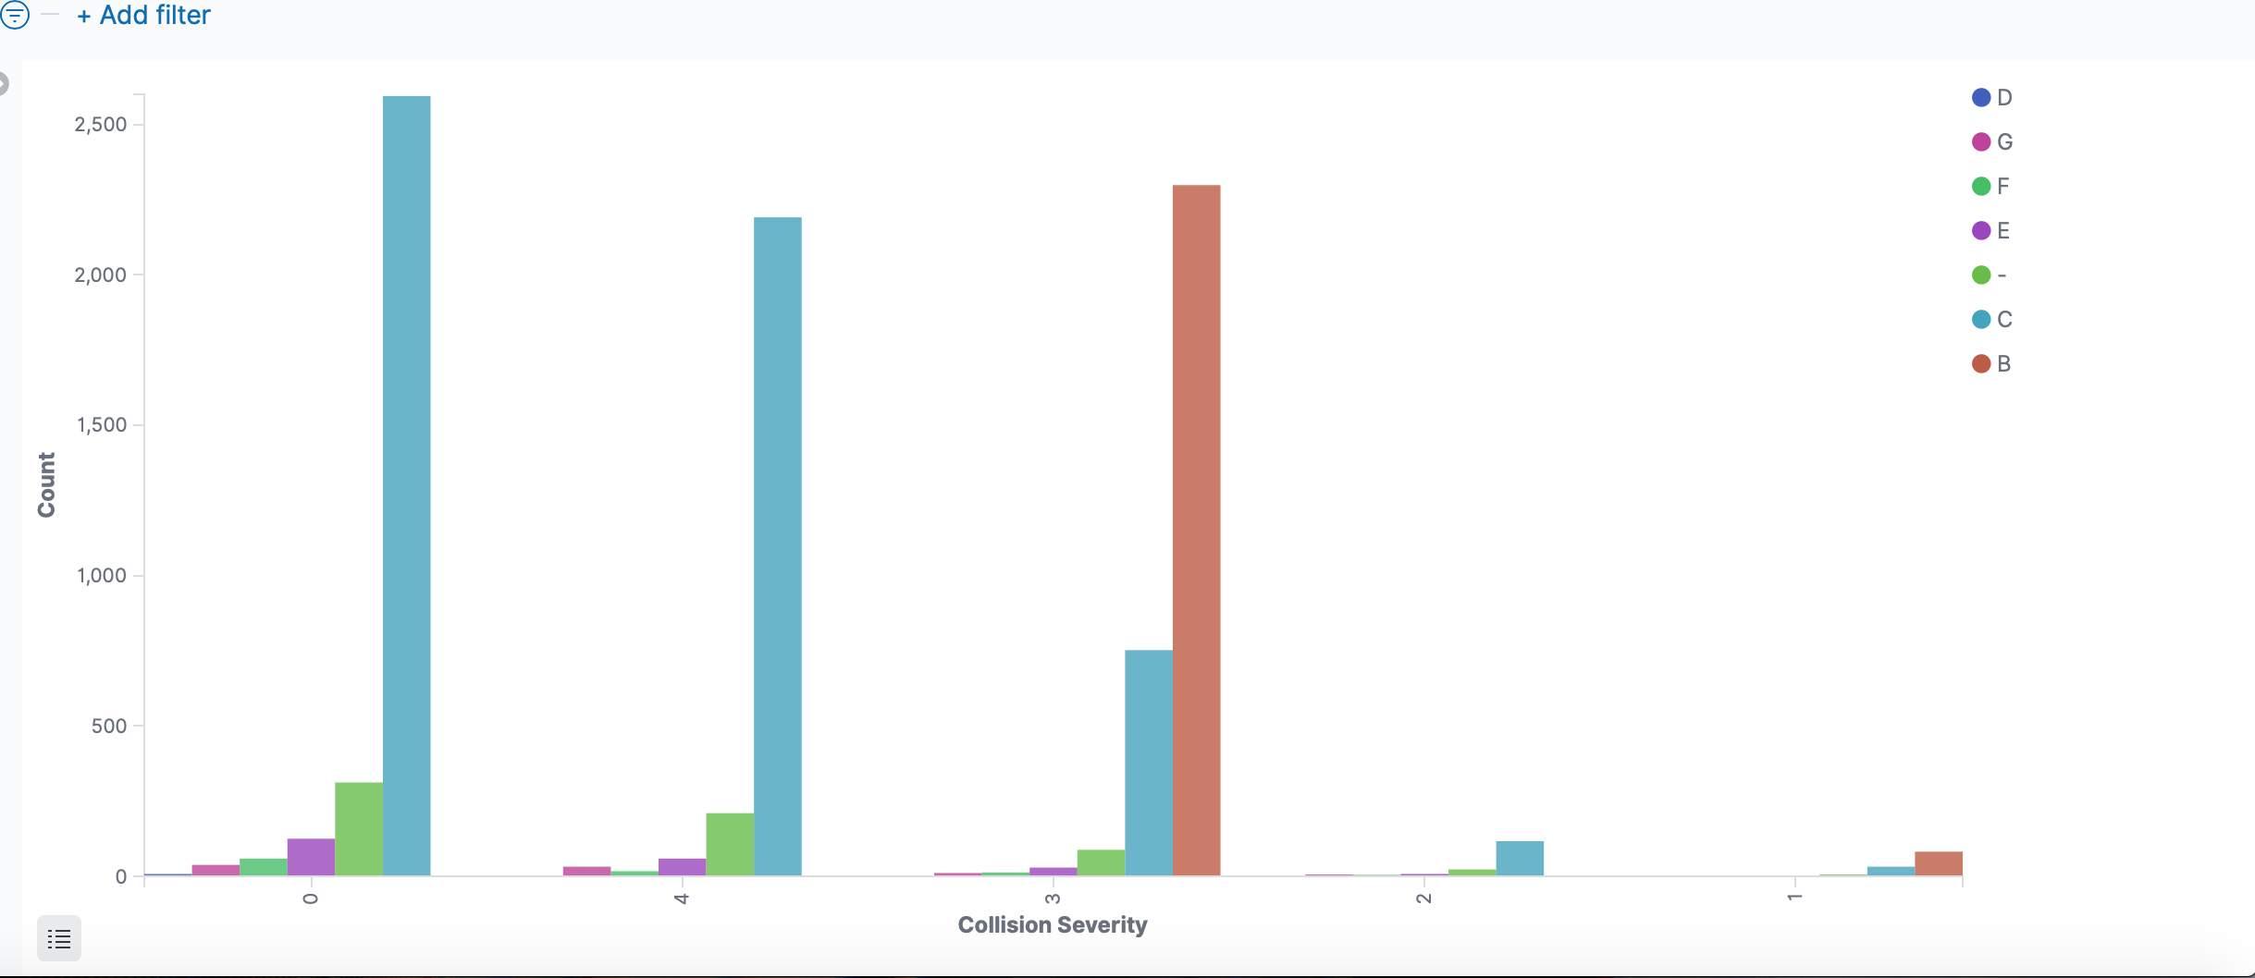
Weather and Road Conditions
Collision Severity
1. Fatal, 2.Injury(Severe), 3. Injury(Other Visible), 4.Injury (Complaint of Pain), 0.PDO
Weather Conditions
A - Clear, B - Cloudy, C - Raining, D - Snowing, E - Fog, F - Other, G - Wind, - - Not Stated
Road Conditions
A - Holes, Deep Ruts, B - Loose Material on Roadway, C - Obstruction on Roadway, D - Construction or Repair Zone, E - Reduced Roadway Width, F - Flooded, G - Other, H - No Unusual Condition, - - Not Stated

Slide 9
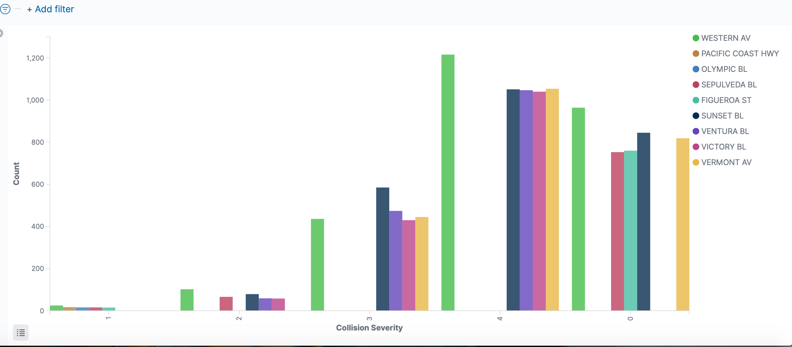
Types of collisions in primary roads
Fatal
Injury (Severe)
Injury (Other Visible)
Injury (Complaint of Pain)
PDO

